Slide 1
Function follows Form
The Whos, Wheres, Hows, Whys and Whens of All the Forms Graduate Students Need to Submit at SUNY ESF

Slide 2
Graduate Forms
A complete list of fillable forms is found on the Grad School’s webpage: https://www.esf.edu/graduate/current/graddegreq.htm
EB-specific forms are found on the departmental webpage: https://www.esf.edu/efb/graduate/forms.htm

Slide 3
Why Forms?
Collect information for quality assurance
Monitor (and ensure) student progress
Assure adherence to Grad School policies and procedures
Allow departmental and Grad school oversight and input
Facilitate common understanding between student, steering committee and department
Requirements
Timeline

Slide 4
“Foundational” Forms
Form | Degree/Program | Due Date
Steering Committee Appt (2a) | FT Students | Steering committee established and met by end of 3rd semester. 1st or 2nd semester recommended.
 | PT Students | After 12 credits
Program of Study (3b) | M.P.S. | By end of 1st semester.
 | M.S. | End of 3rd semester. Recommend develop during 1st semester and file with Grad School in 2nd semester.
 | Ph.D. | End of 3rd semester. Must be completed before candidacy.
Proposal | M.S. | 2 semesters before defense of thesis.
 | Ph.D. | To achieve candidacy.

Slide 5
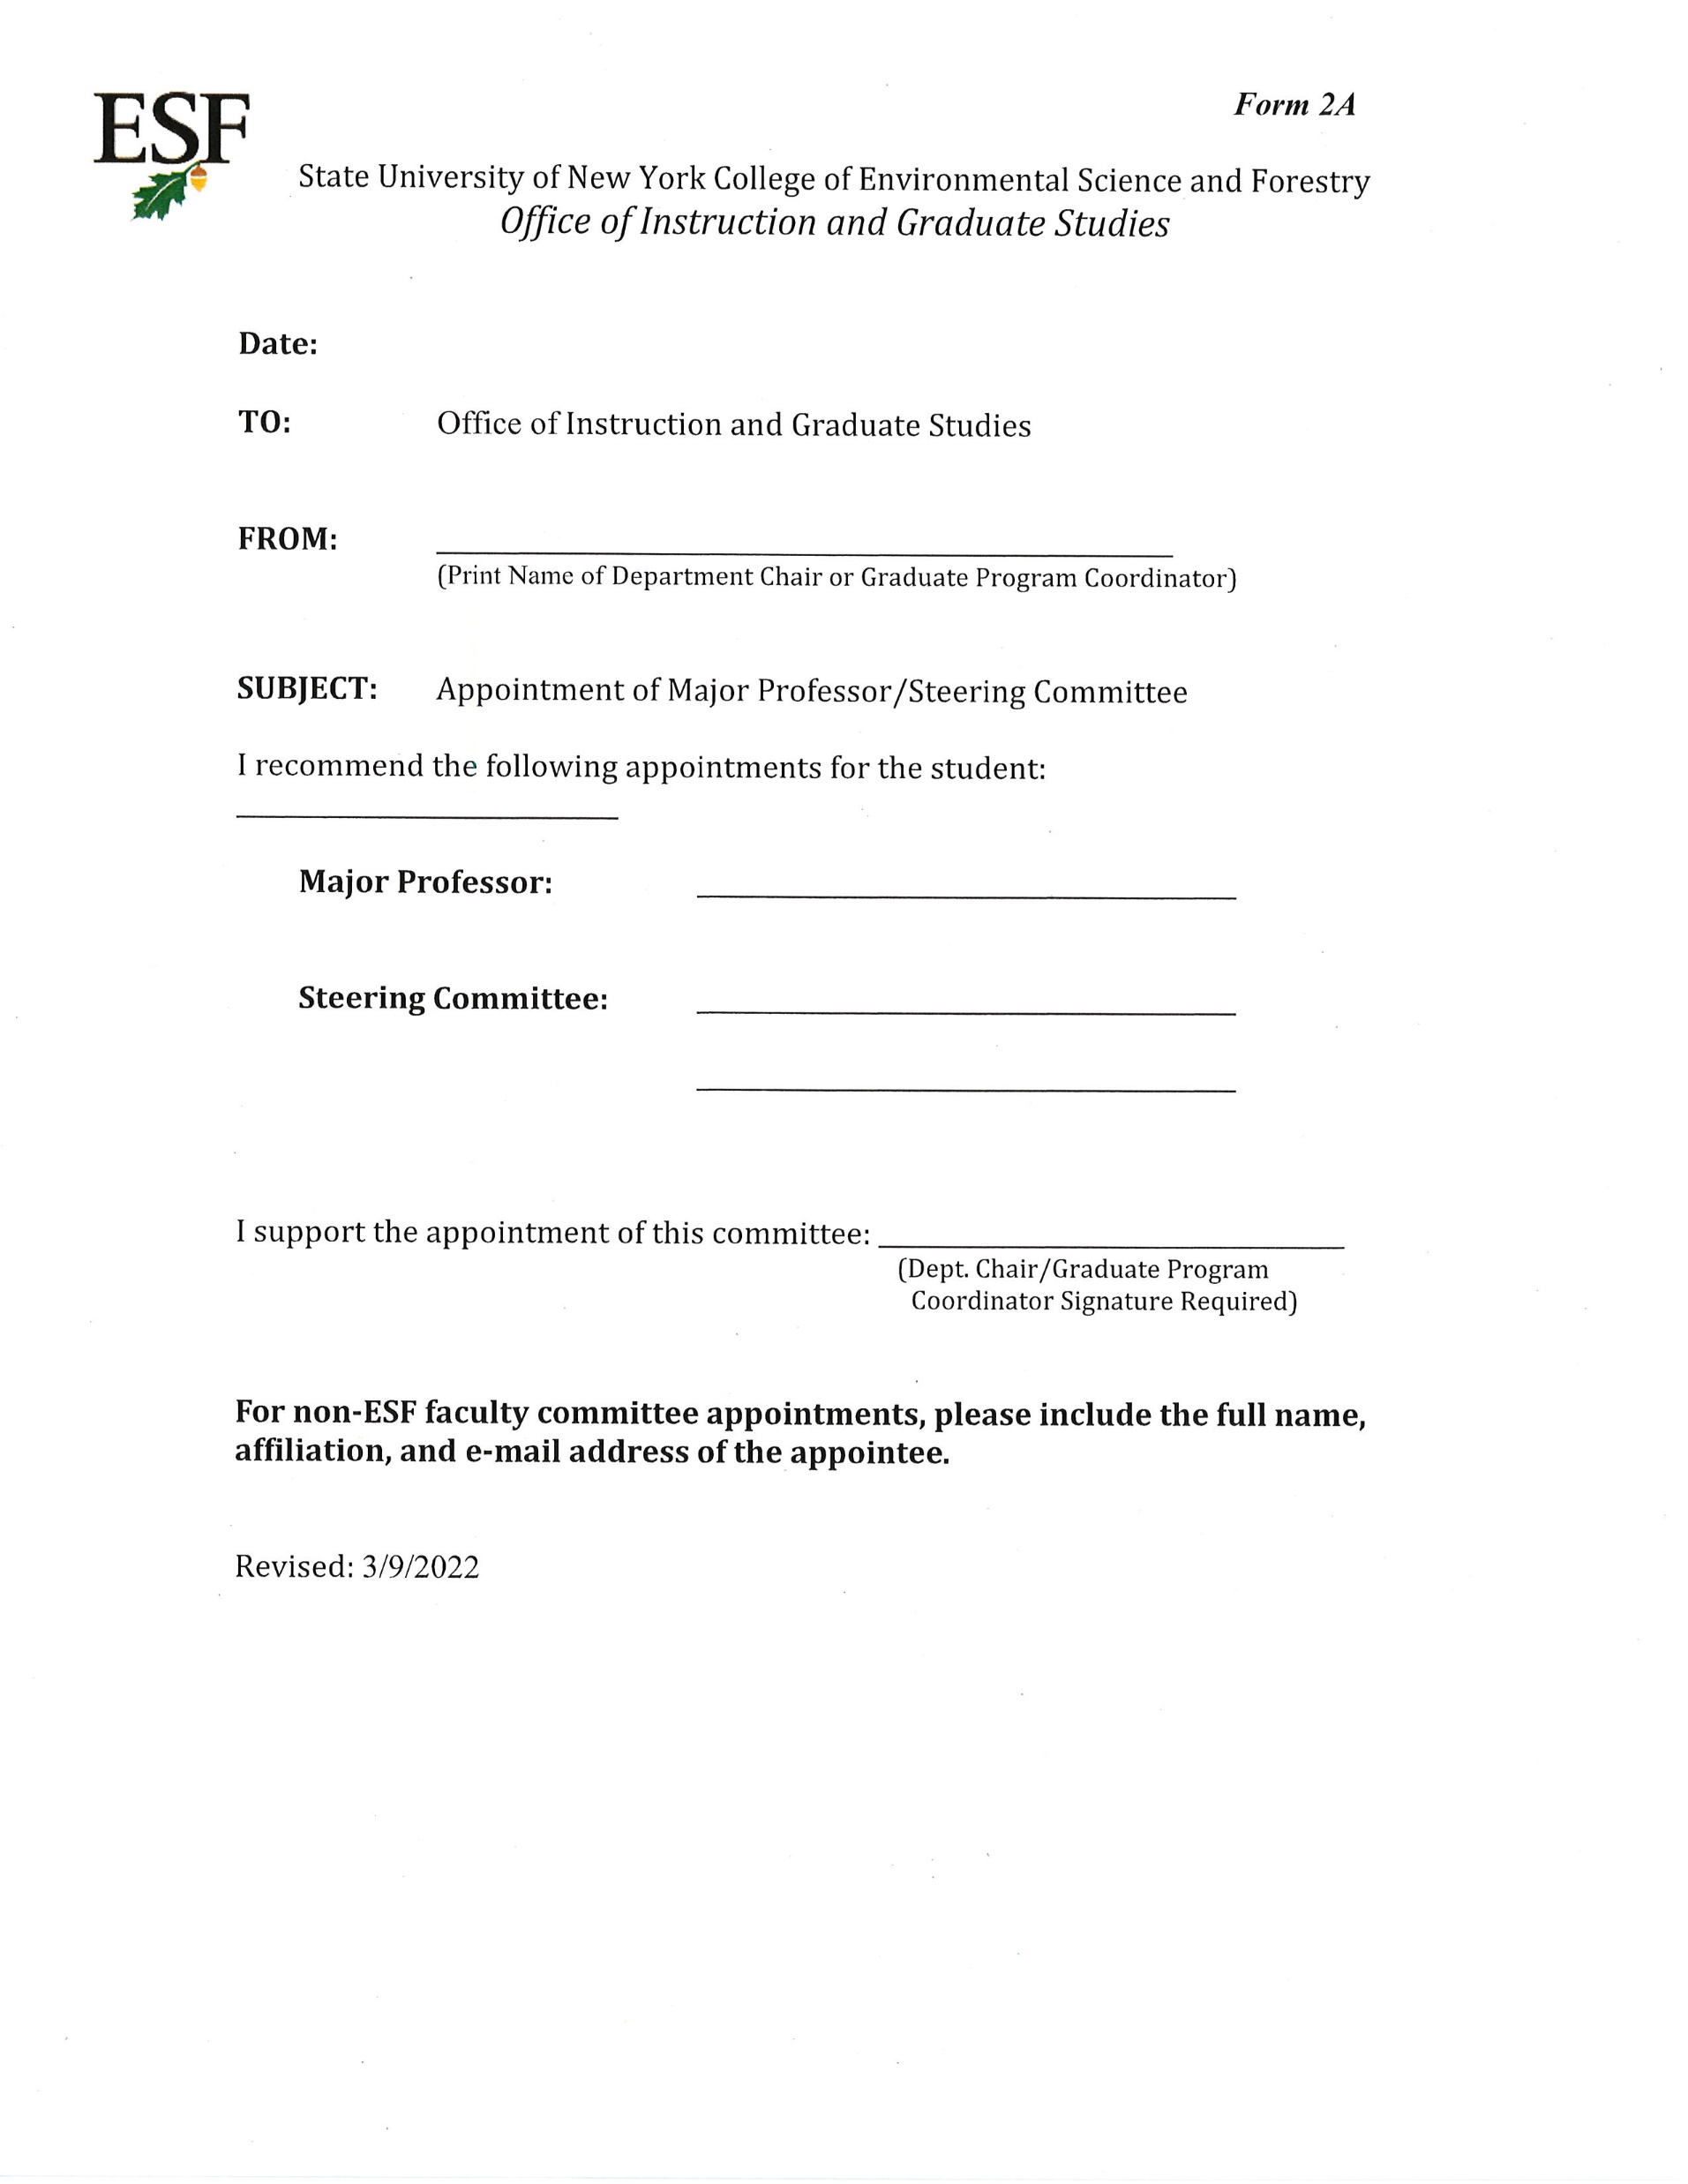
Appointment of Committee
Major Professor
Primary advisor
May change with 2a
Must be ESF faculty member in your department
May list co-major professor
Steering Committee
2 for research degrees
1 for professional degrees
May include other qualified people such as faculty at other schools or recognized professionals
Committee must be approved by Department Chair or Grad Coordinator, depending upon dept policy/convention

Slide 6
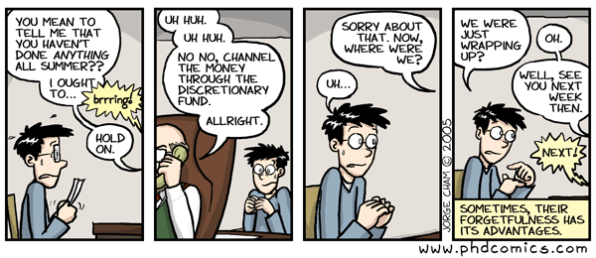
Steering Committee
MP, with assistance of steering committee, guides your coursework and research (or project) and serves as your final examining committee
Student should consult with MP for selection of steering committee

Slide 7
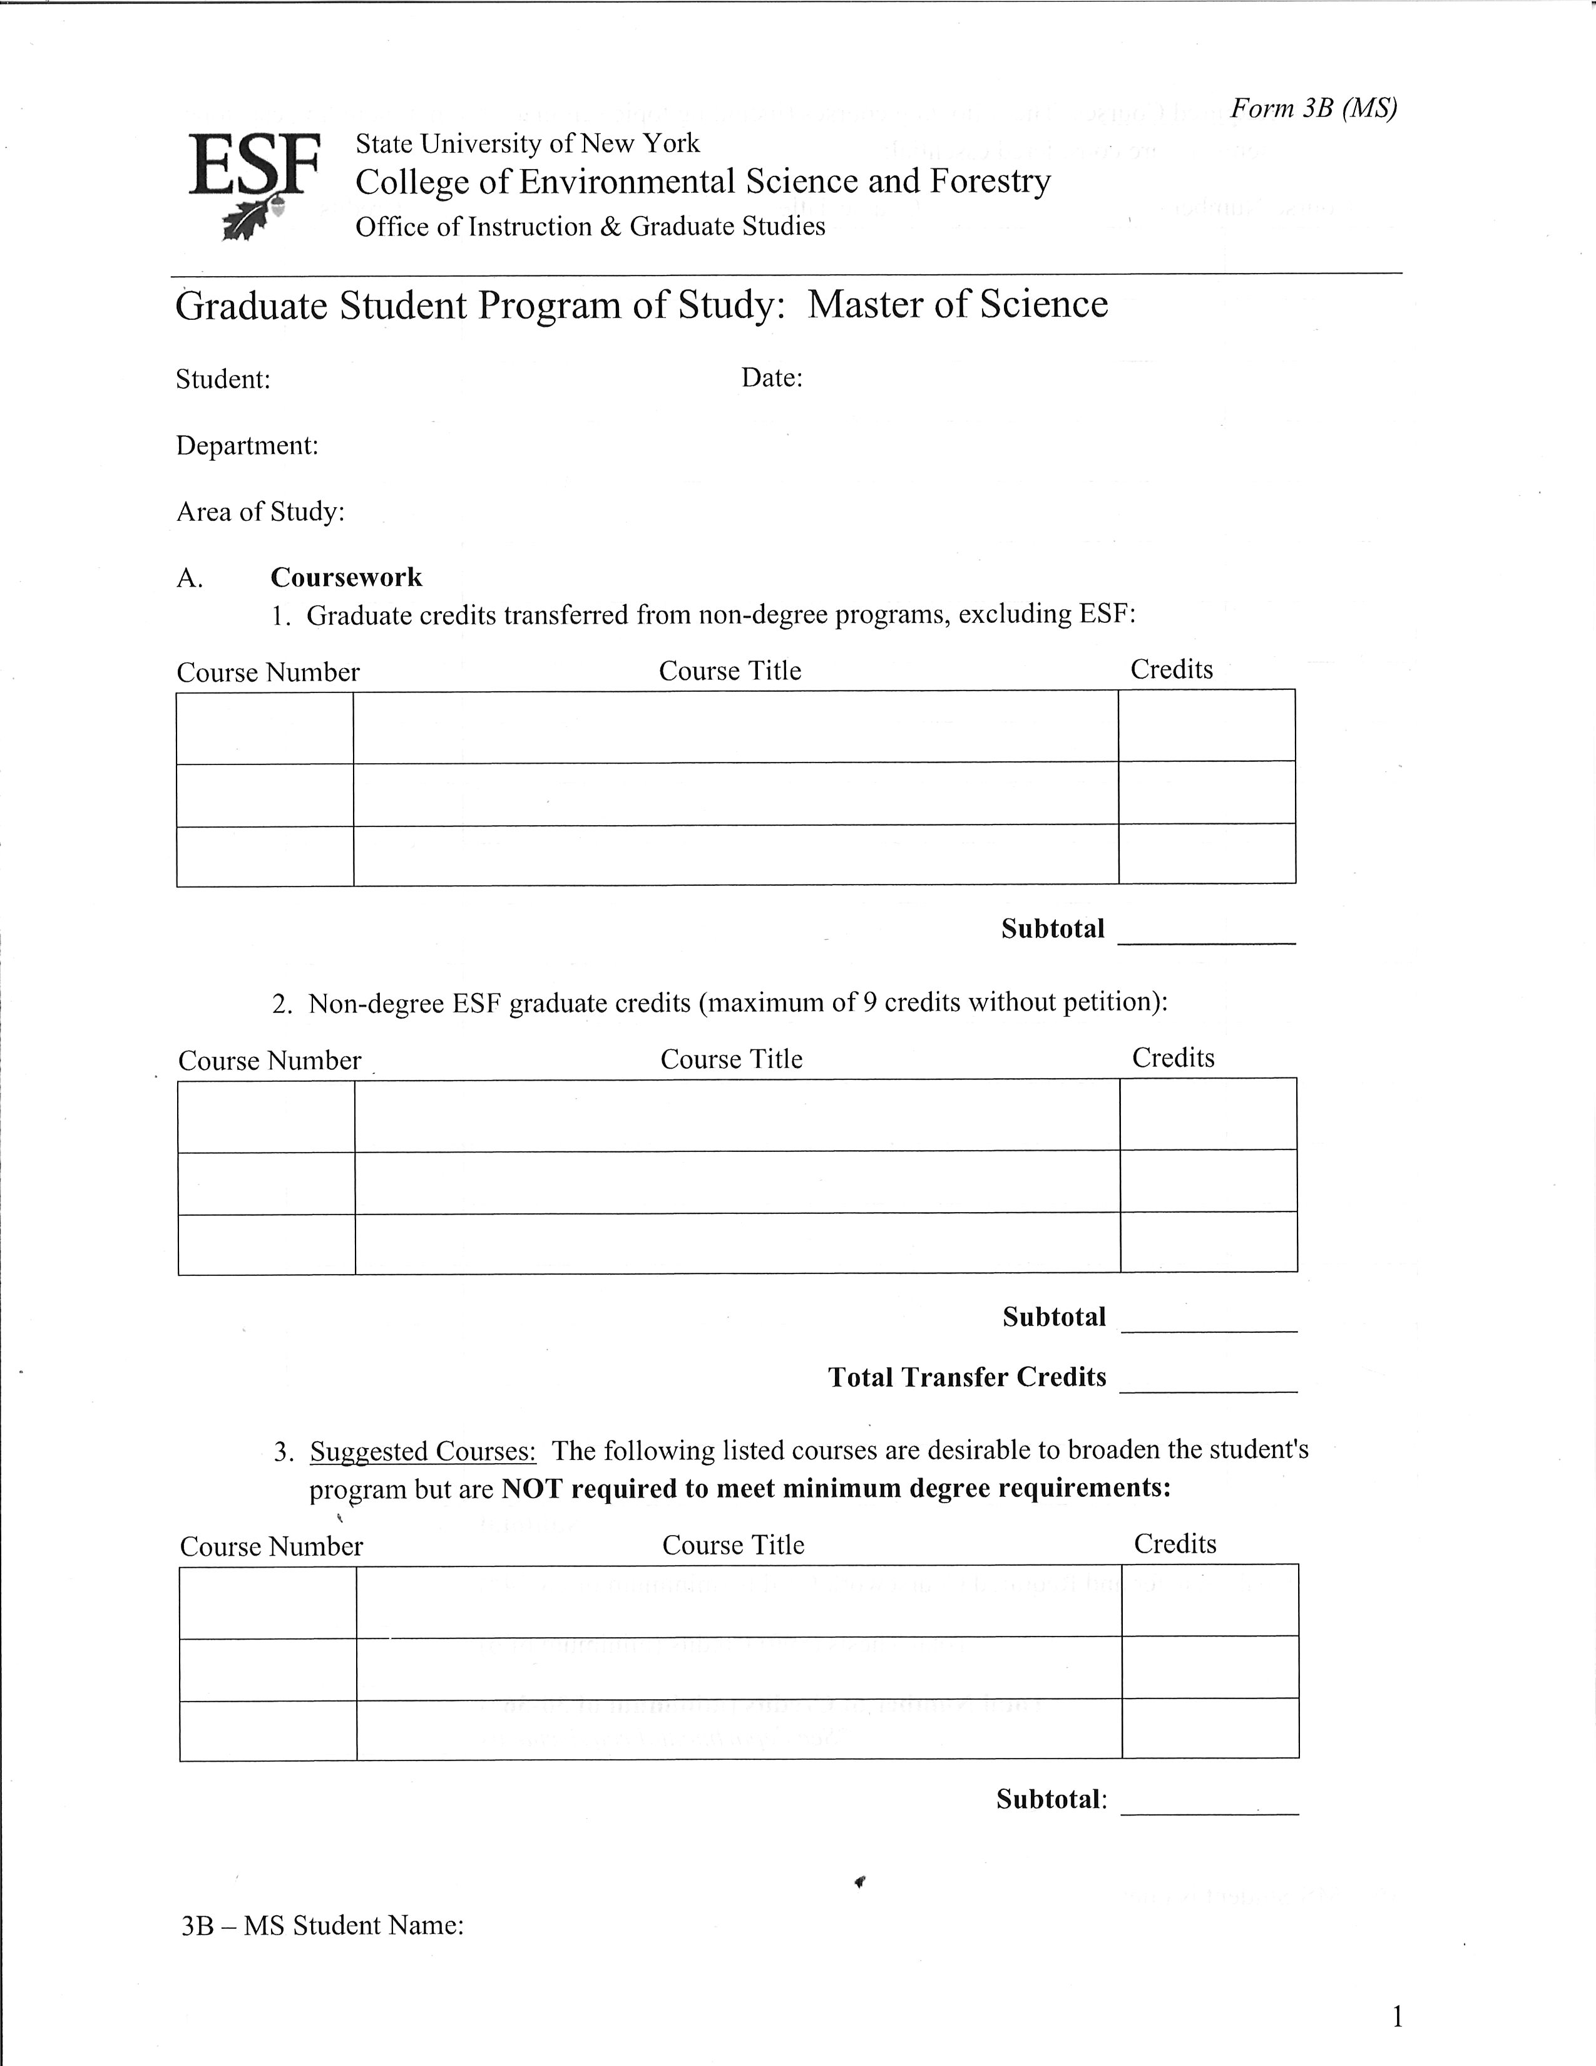
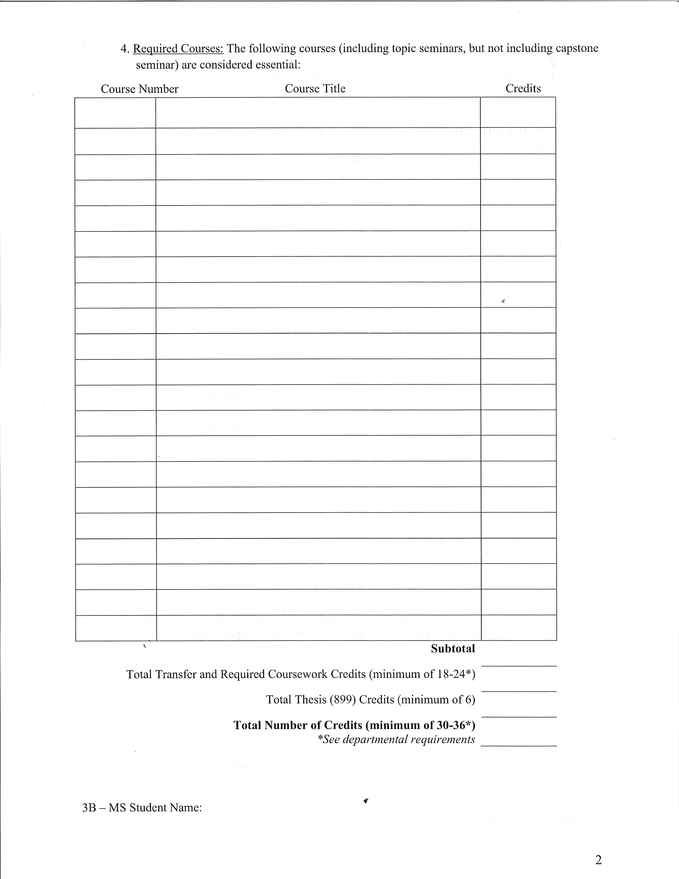
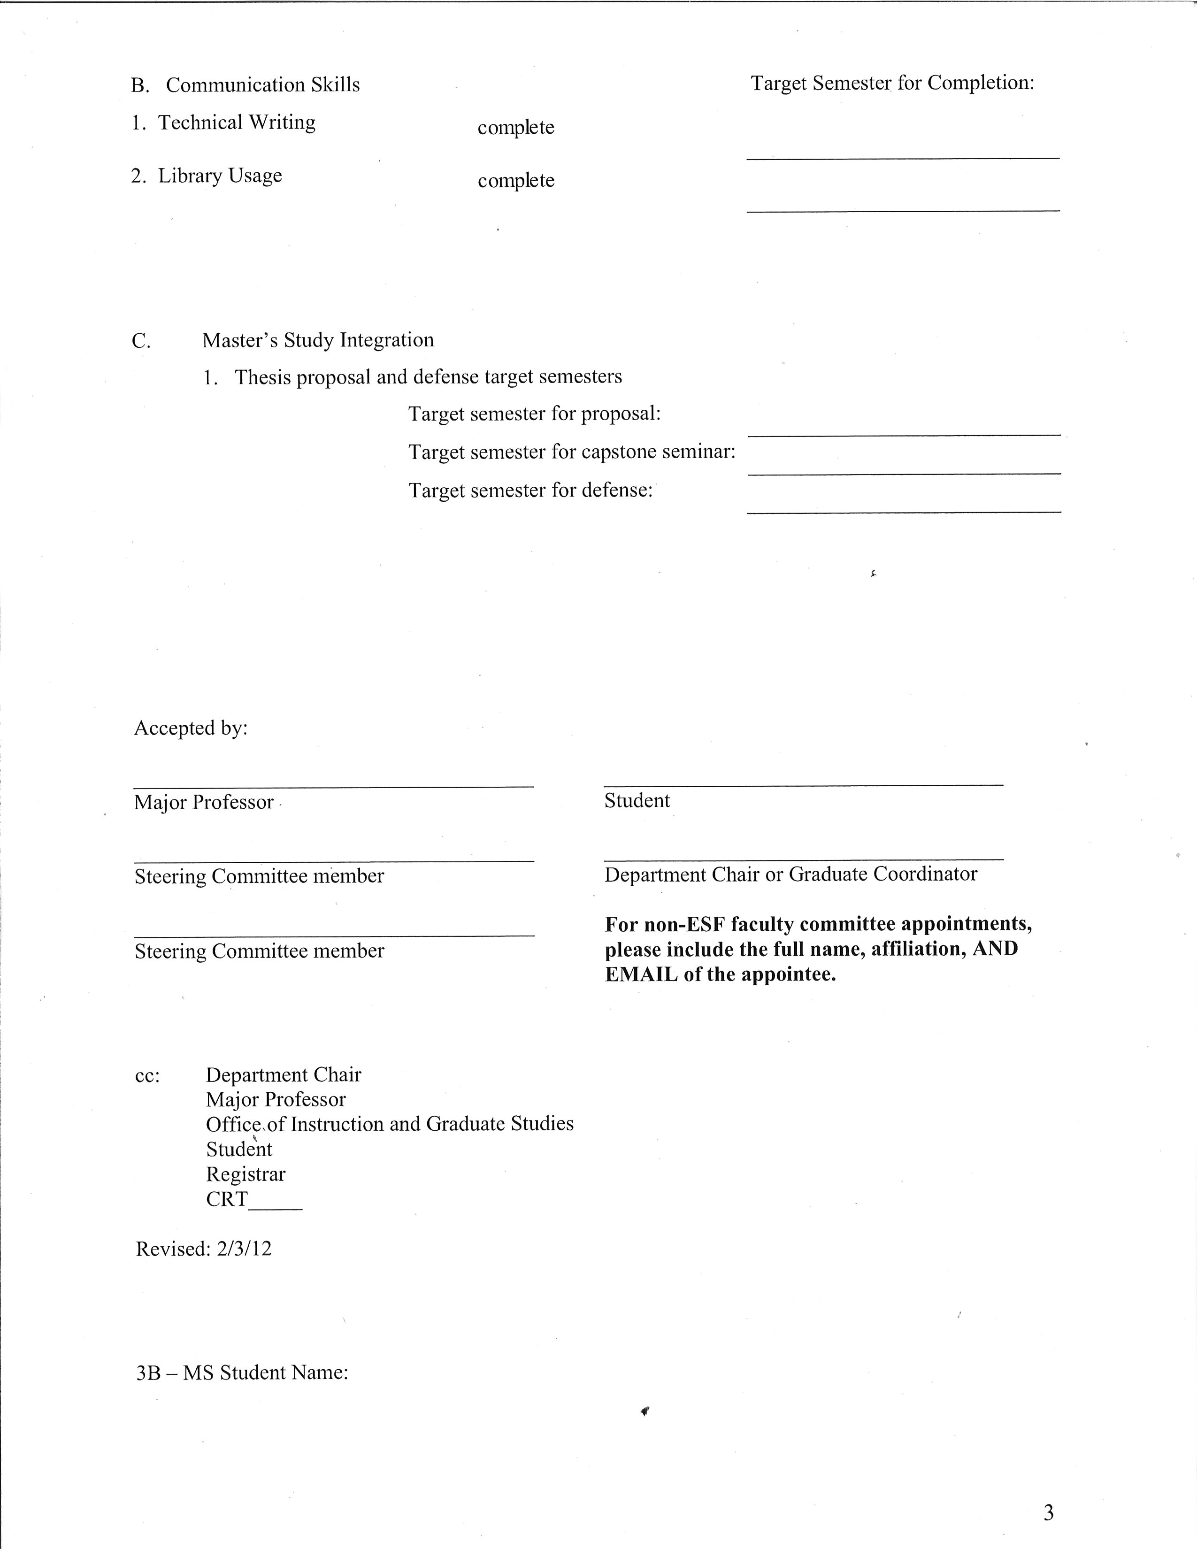
Program of Study
Grad students may transfer 6 non-degree credits. Ph.D.s may also transfer 30 credits from Master’s program. Must petition to add.

Slide 8
Time Limits
Master’s students must complete all requirements for degree within 3 years of matriculation or they may be withdrawn from graduate study.
Doctoral students must complete candidacy 1 year prior to defense or 3 years after matriculation. They must successfully complete all degree requirements within 7 years of matriculation or may be required to re-take candidacy exam.

Slide 9
Defense Chair Appointment
Finishing MS students and PhD candidates should submit form 5B requesting appointment of an exam committee about three to four weeks into the semester.
Must have approved 2A and 3B forms on file.
The Grad School will appoint an exam chair who will:
manage the defense
ensure its integrity
represent the interests of both the student and faculty
Professional master’s students who do not have a defense will need to notify The Grad School that they will be graduating by answering graduation survey
Notes:
Once you have your steering committee (2A) and 3B in place, you will need to request a chair in the semester in which you plan to defend.
Complete the 5B in consultation with your major professor and get it signed by the Department Chairperson
If we do not have your 3B on file, the request will be held up until we have your 3B.
How many of you still need chair assignments for this semester?
9

Slide 10
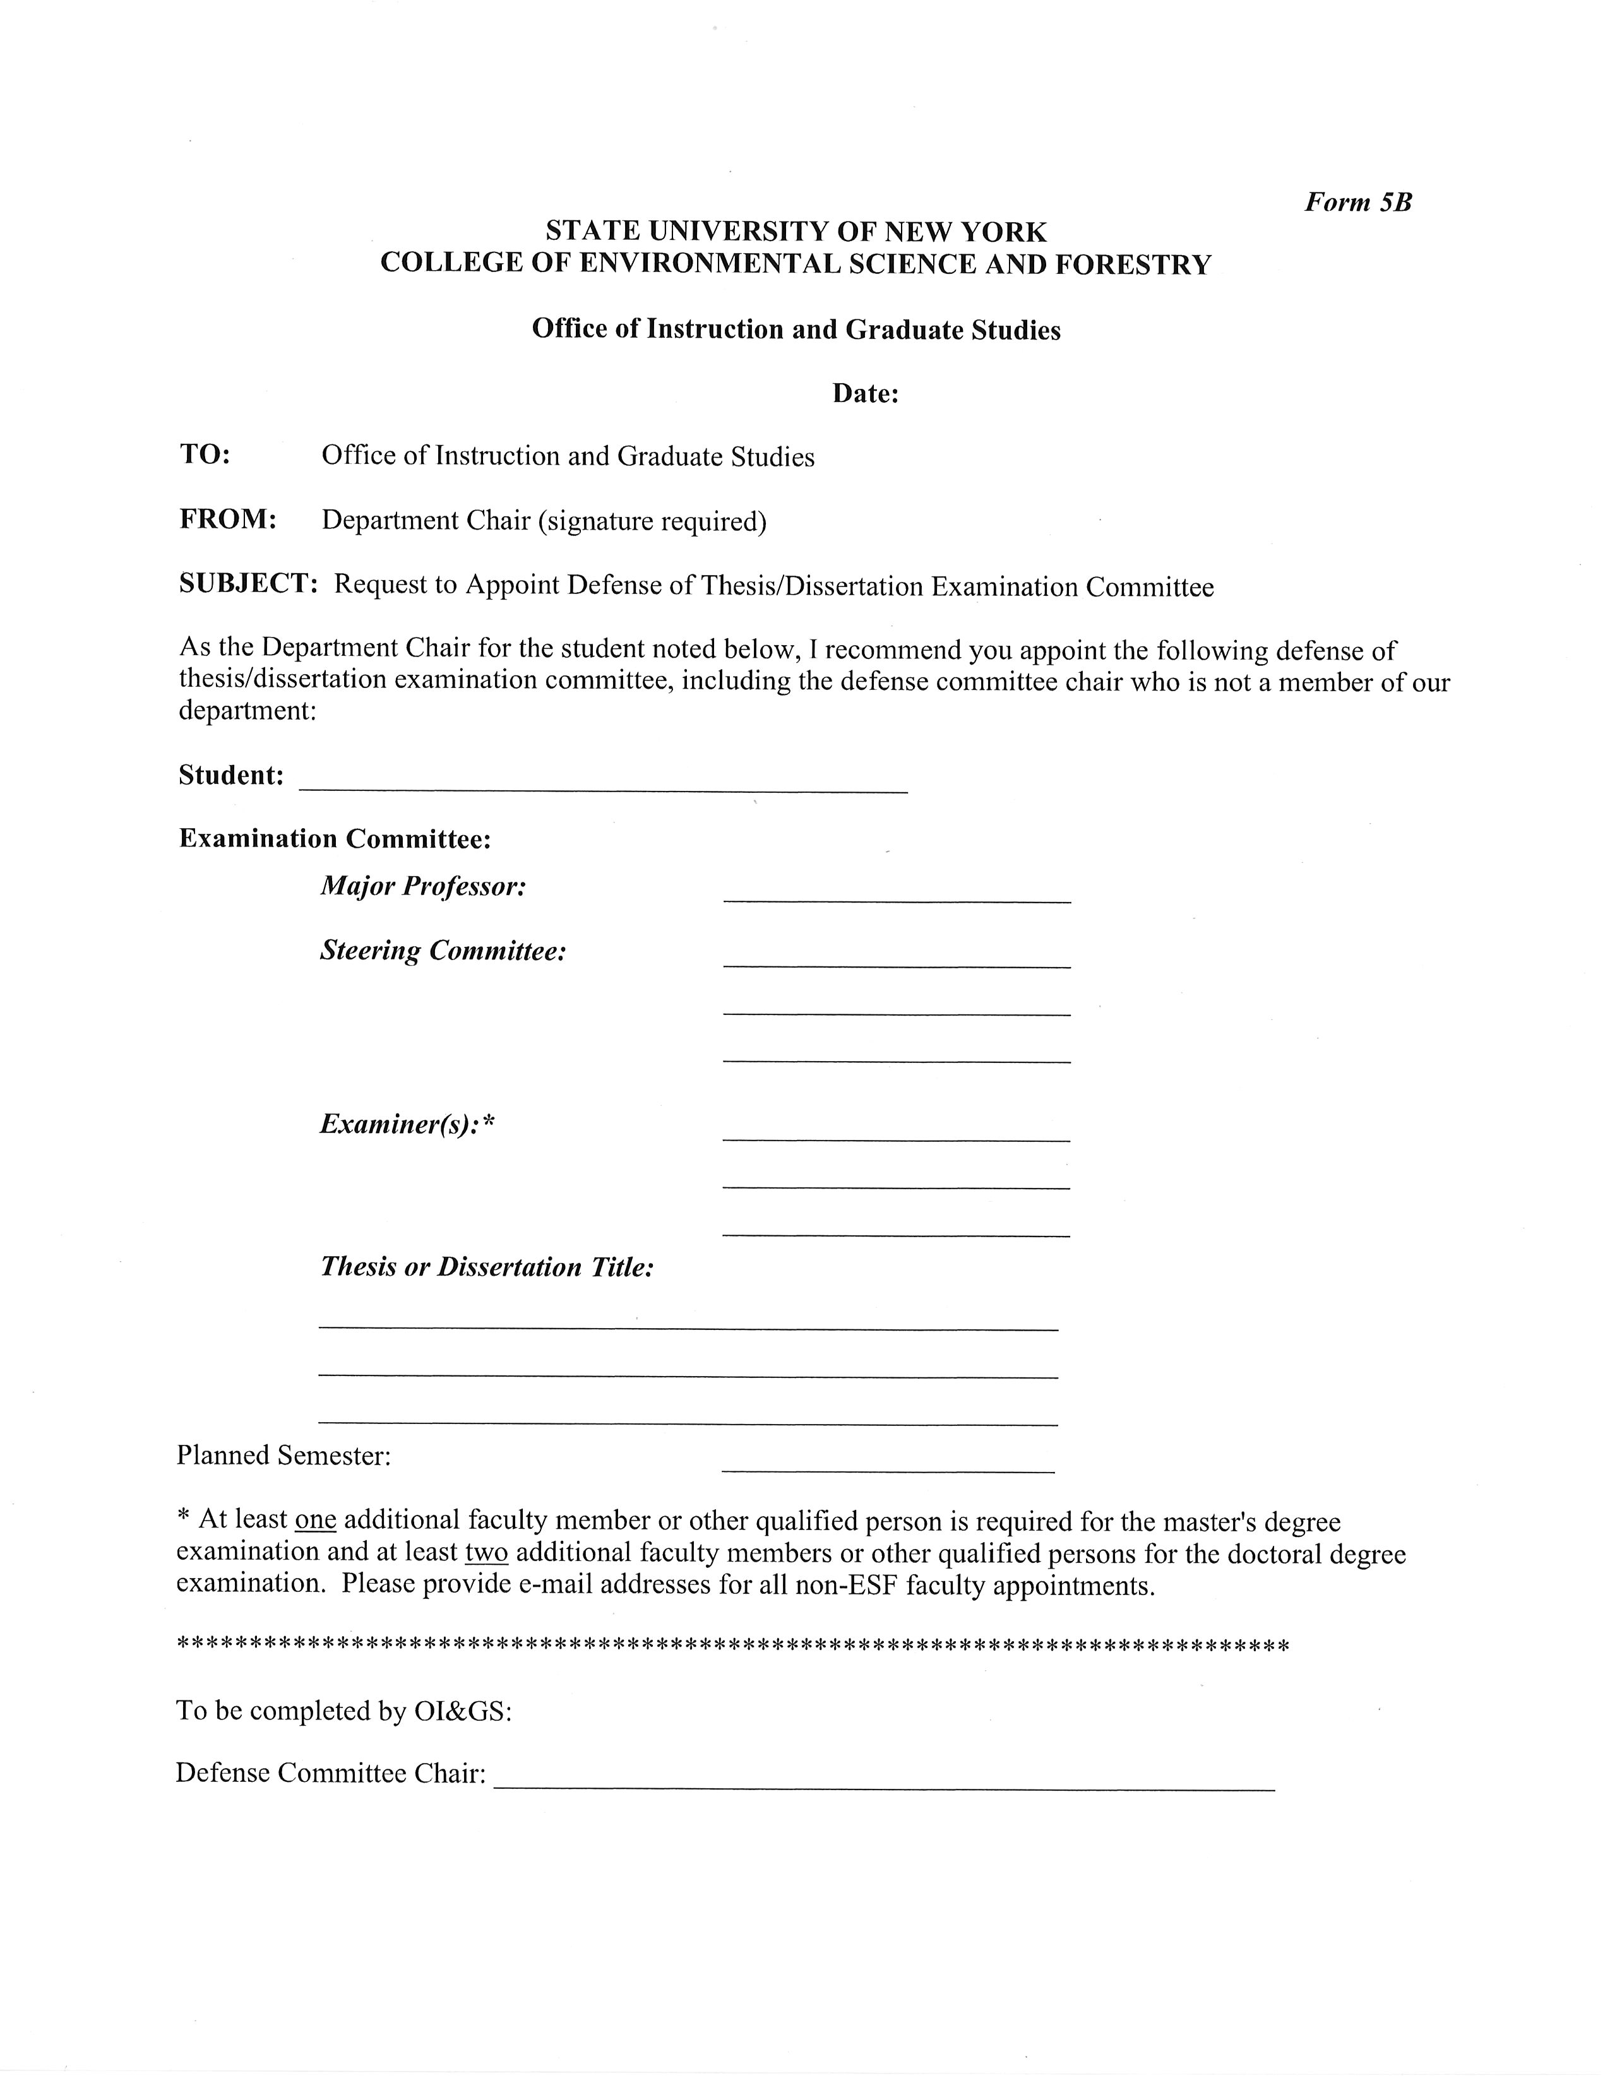
Defense Committee
Committee Structure
Thesis Defense: Committee (major professor plus at least two steering committee members), one examiner, and the chair.
Dissertation Defense: Committee, two examiners, and the chair.

Slide 11
Defense Examiner
The examiner reads the thesis/dissertation and participates fully in the oral exam but is not involved in the actual supervision of the thesis/dissertation. Examiner information must be included in the 5b (including email address, if not ESF faculty).

Slide 12
Defense logistics
The defense usually lasts two hours, and it is expected that all committee members stay through its entirety.
Students are required to submit their thesis or dissertation to all committee members at least 14 days prior to the defense.
Within five days of oral defense, the major professor confirms with committee that oral defense should proceed as scheduled.
Students may invite one other student to serve as a silent observer during the defense.
Notes:
While OIGS prefers all members of the graduate committee to be present during the defense,
members may participate via video conferencing or Skype if they cannot be on campus for the
defense.
Students may not skype themselves in for the defense!
12

Slide 13
Final Steps
5b triggers a series of emails and forms which walk M.S. and Ph.D. students through the necessary steps to graduation
Capstone seminar is required for all MS and PhD degrees and usually for MPS, MF, and MLA degrees
The capstone lasts approximately one hour and usually immediately precedes the defense. It is the student’s responsibility to coordinate the date, time, and location of the capstone with the department, not The Graduate School

Slide 14
Petitions
A petition is the official way to request action on academic matters that are not routine. The petition serves as the written record of the action taken on a request and serves to notify the petitioner, their faculty advisor, and the Registrar of the action taken.
Form 4 – Revising Existing 3b
Petition for Extension of Time Limit for Degree Completion
General Petition

